Slide 1
Telecom Customer Churn Analysis
.

Slide 2




Excel Python MySQL Power Bi
Tool used for the project

Slide 3
About the Data : Introduction to a dataset that has been used for the project. Steps of Data Cleaning & EDA : Various steps are used for data cleaning & EDA. Problem Statement : Problem statements are solved in this projects. Dashboard : The view of a dashboard that has been created. SUMMARY : Summary has been added at the end .
Agenda

Slide 4
The dataset shows the customer’s account details like customerID, gender, Senior Citizen, Partner, and whether dependent on someone or not. It shows various services that each customer has signed up like phone service, tenure, Multiple lines, Internet service, Online Security, Online Backup, Device Protection, Streaming TV & Movies and Tech support. It also shows customer account information like a contract, payment method, paperless billing, Monthly charges and Total Charges. Customers who left this column is called Churn.
ABOUT THE DATA

Slide 5
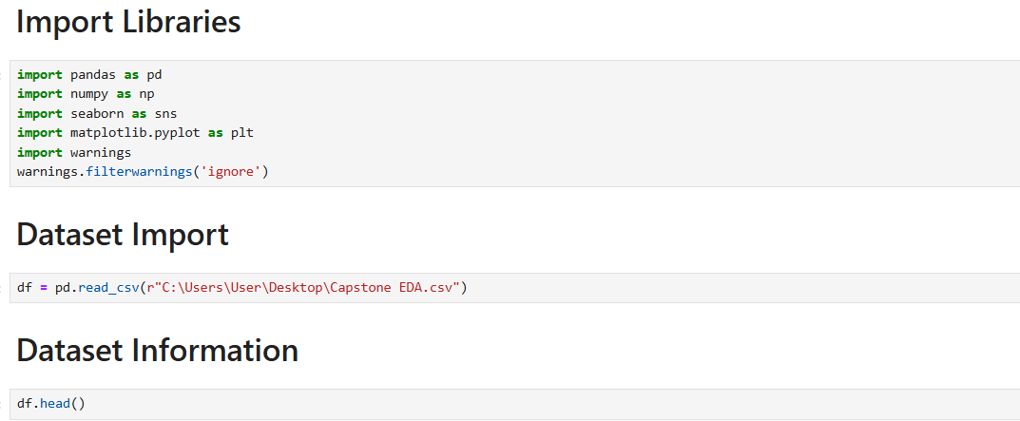
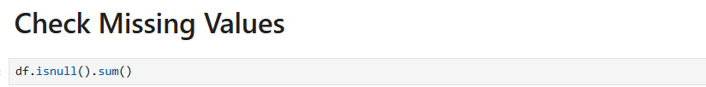
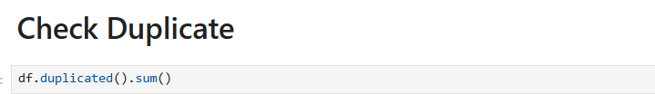
Import data from Excel to Python. Dataset Information to understand the data Checking if any missing values present in the data. Checking any duplicate value present in the data.
Steps of data cleaning

Slide 6
.
EDA

Slide 7
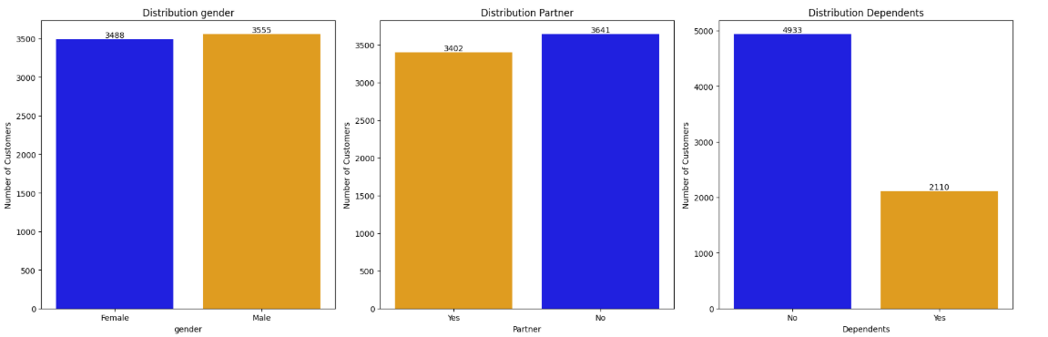
It can be seen that customers based on gender and Partner tend to be balanced. It can be seen in the Dependents column that as many as 70% of the majority of the customers do not have Dependent.
DISTRIBUTION ON CUSTOMER DEMOGRAPHICS

Slide 8
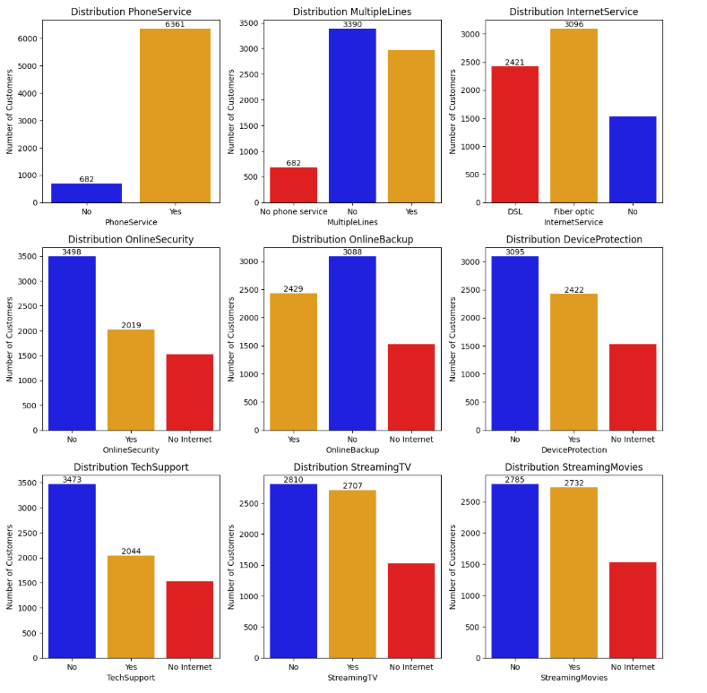
It can be seen that customers to have Phone service and the majority do not have Multiple Lines. Most customer use Fiber optic Internet Service. OnlineSecurity,OnlineBackup,DeviceProtection,TechSupport columns the distribution is unbalanced and most of the customers do not have this services.
DISTRIBUTION ON SERVICE TYPE

Slide 9
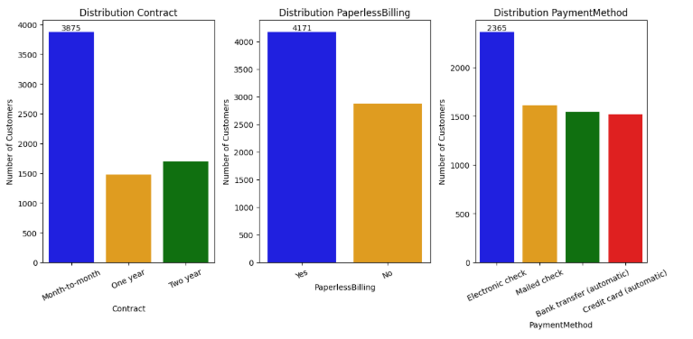
The distribution of payment contract is not balanced and most of customers made payments monthly. The most of the customers use Paperless Bills. Most of the customer pays through Electronic Payment and other payment methods are balanced.
Distribution on payment type

Slide 10
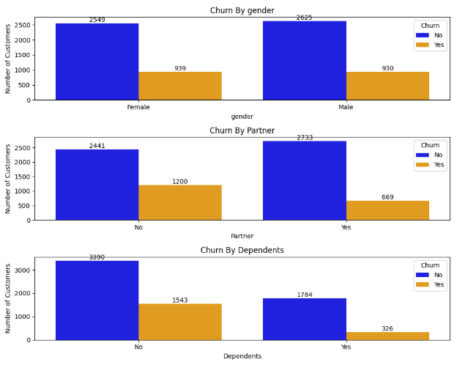
It can be seen that Churn does not affect gender because the numbers for both male and female are almost same. It can be seen that Churn is more in more in customers who does not a Partner. It can be seen that Churn is more in more in customers who are not Dependents.
CHURN ON CUSTOMER DEMOGRAPHICS

Slide 11
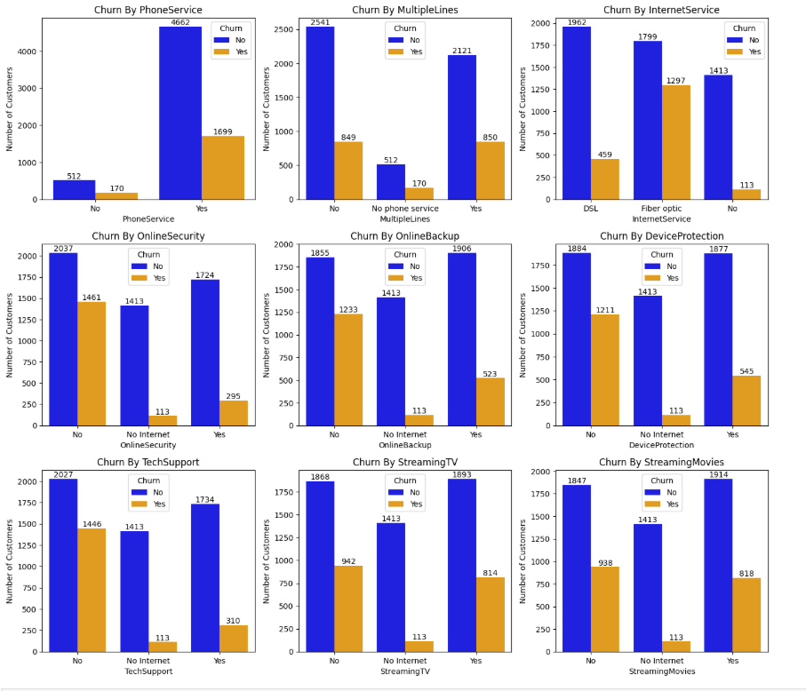
For Churn on Multiple Lines, it seems to be the same for customers who have multiple lines or not. For Churn on Internet Service, Fiber optic users Churned mostly than the others. Customer who don't have / are provided Online Security, Online Backup, Device Protection and Tech Support churned Mostly. Streaming Tv and Streaming Movies churn customers are almost same.
Churn on service Type

Slide 12
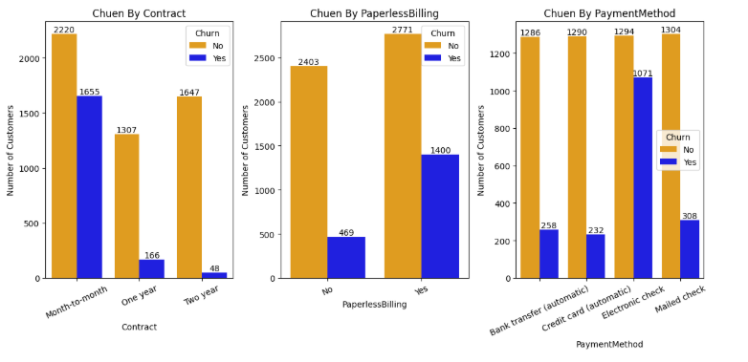
It can be seen that customer churn is dominant in payments made every month compared to other payments. Customers who usually make payments through electronic payments with paperless bills churns most.
CHURN ON PAYMENT TYPE

Slide 13
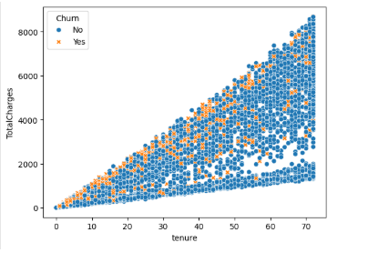
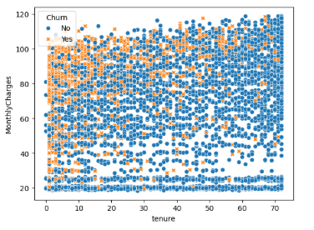
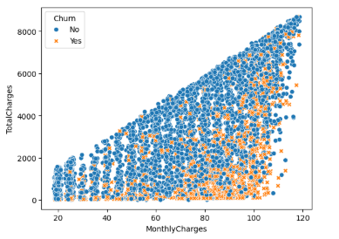
It can be seen that longer tenure with higher Total Charges has higher churn potential. It can be seen that Churn occurs mostly in tenure 0-20 months with large Monthly Charges. Here we see more churn is higher monthly charges with lower total charges.
CHURN BY TENURE VS TOTAL CHARGES VS MONTHLY CHARGES

Slide 14
.
Problem statement

Slide 15
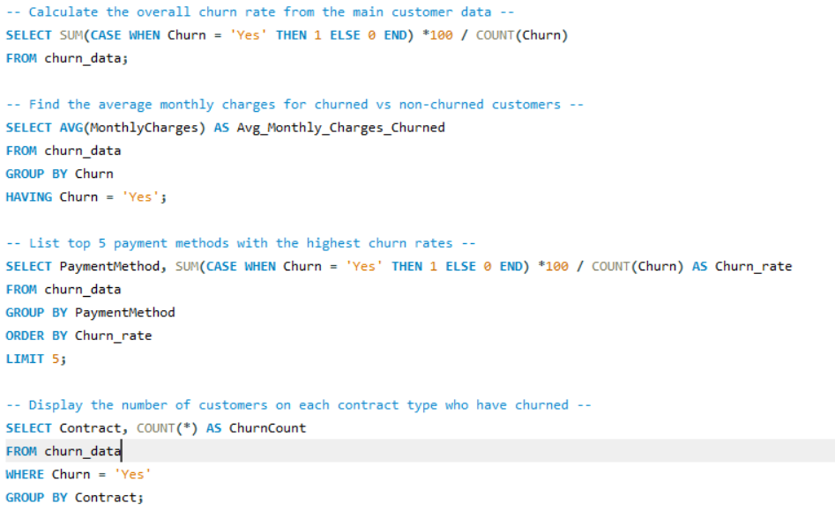
.

Slide 16
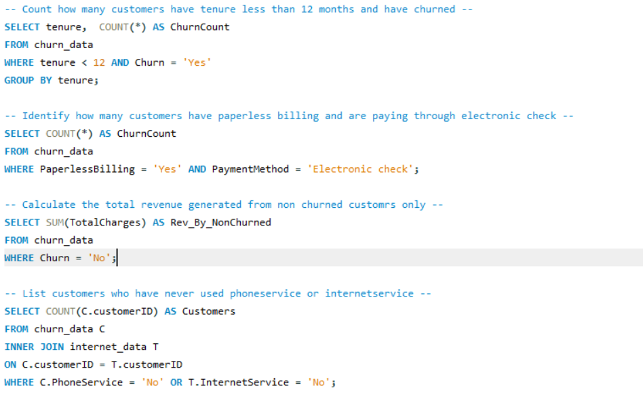

Slide 17
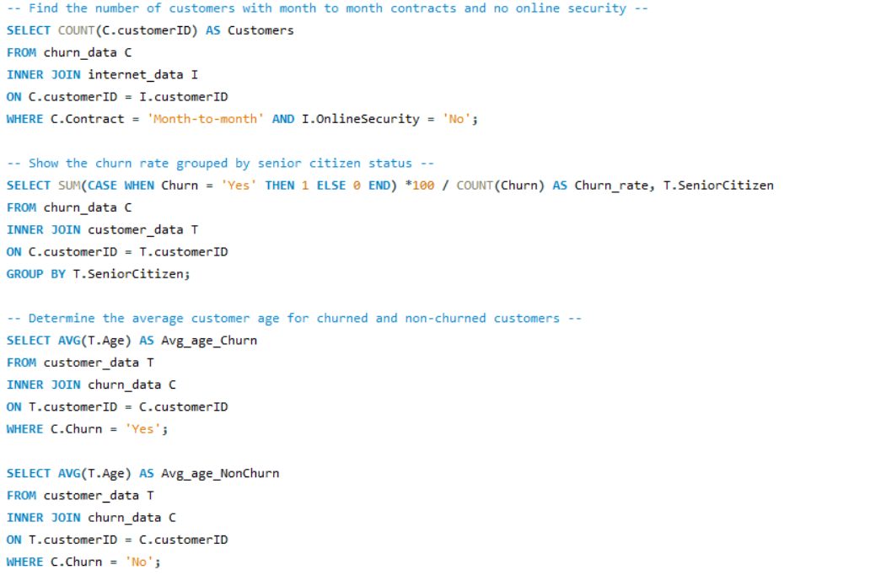

Slide 18
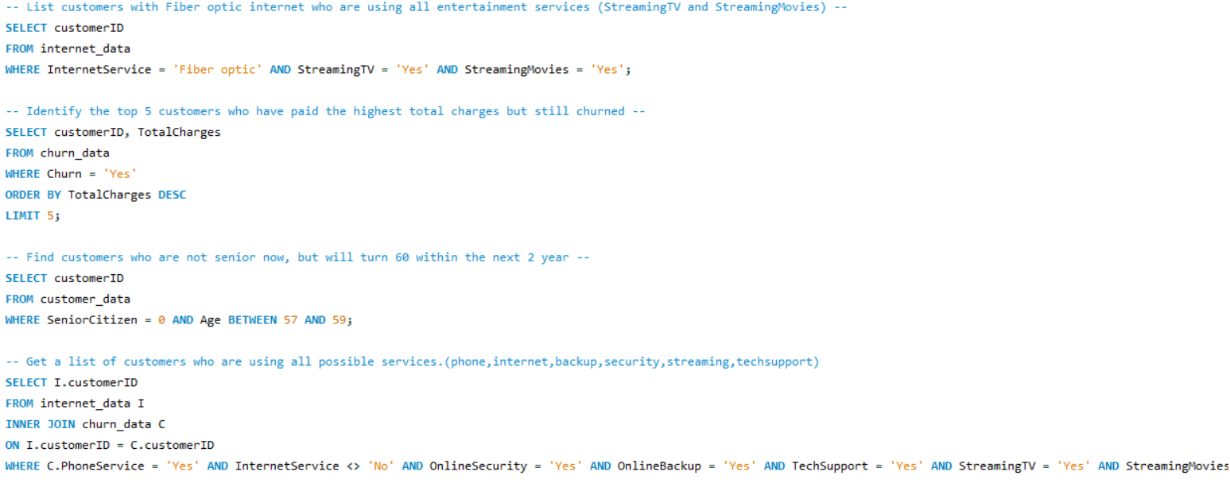

Slide 19
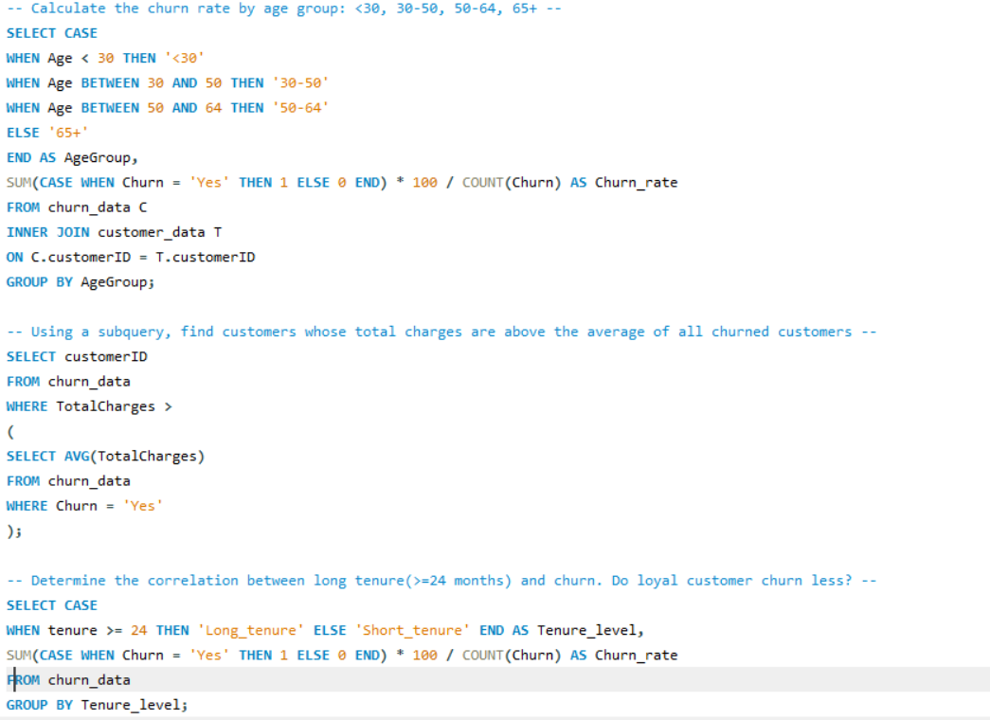

Slide 20
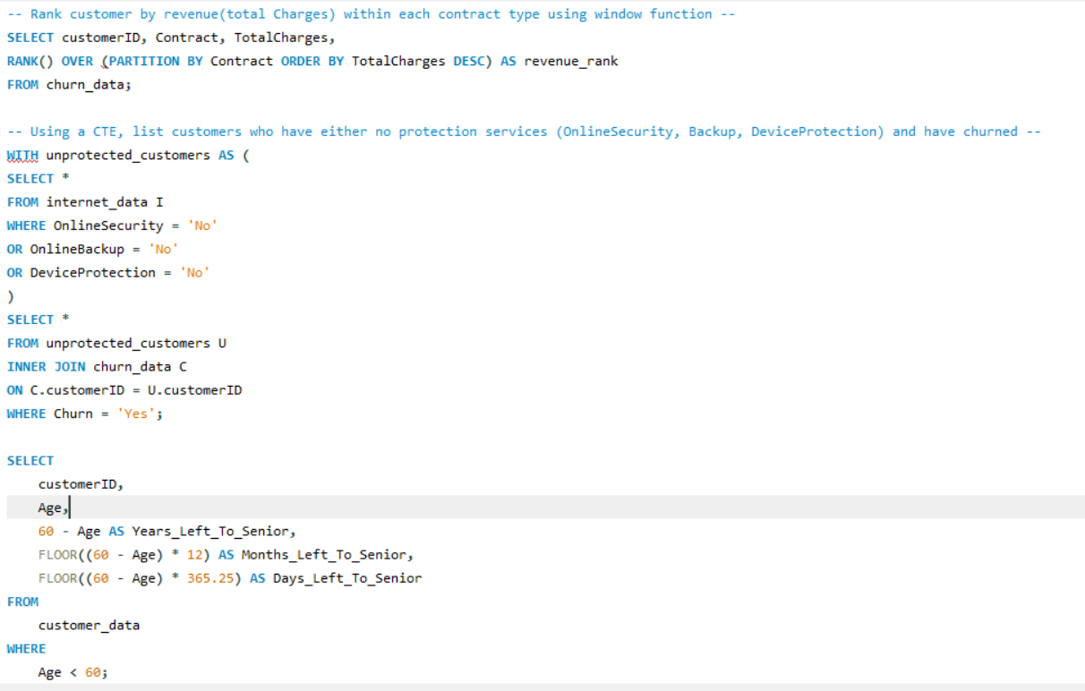

Slide 21
.
DASHBOARD’S

Slide 22
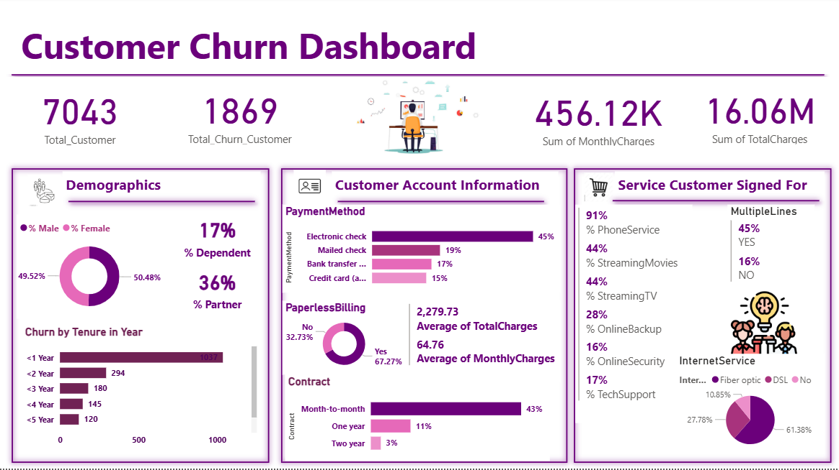

Slide 23
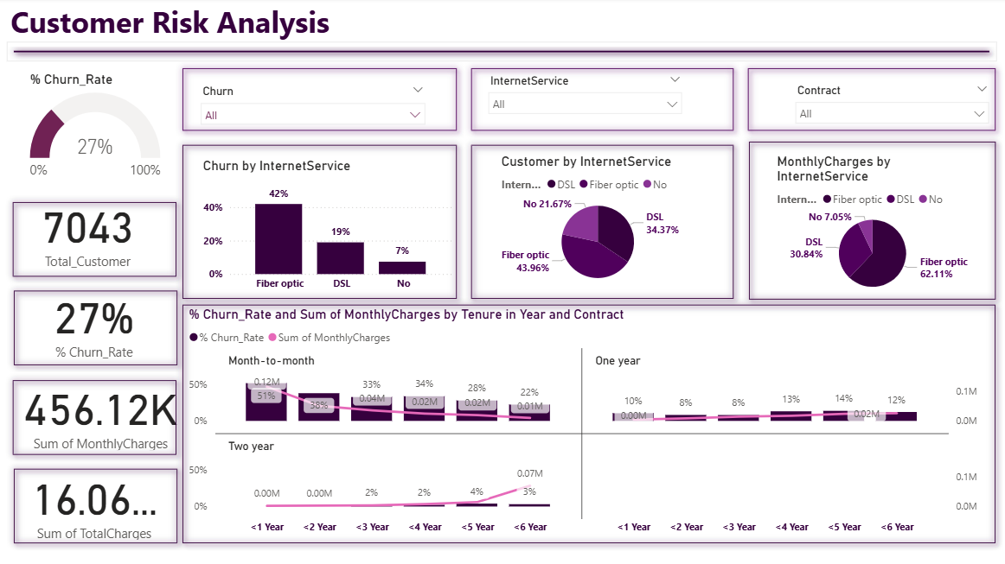

Slide 24
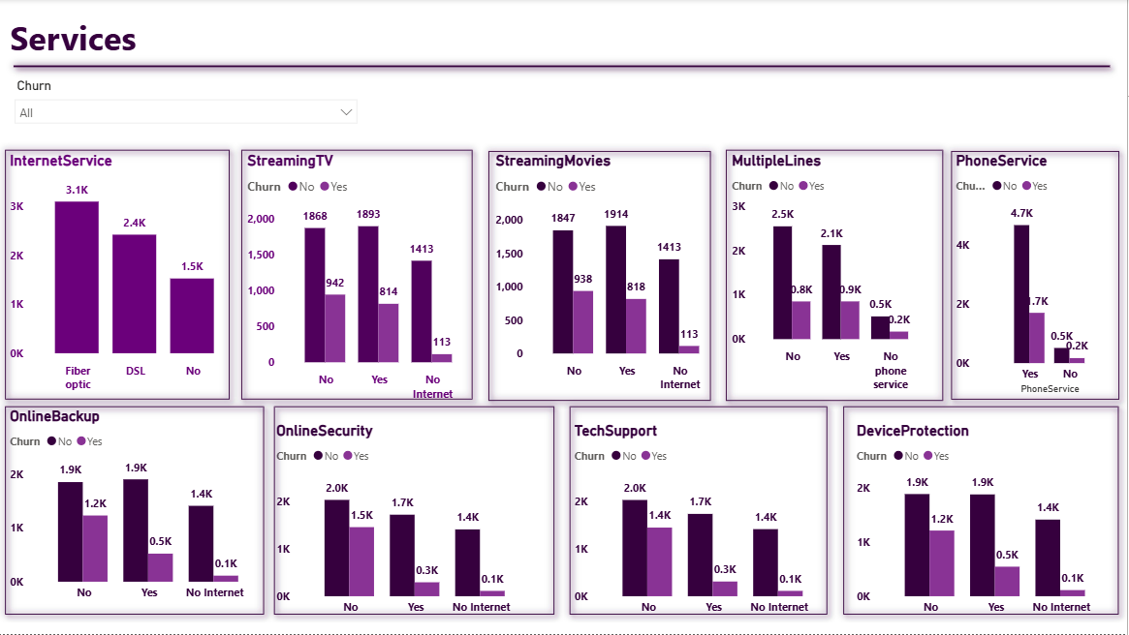

Slide 25
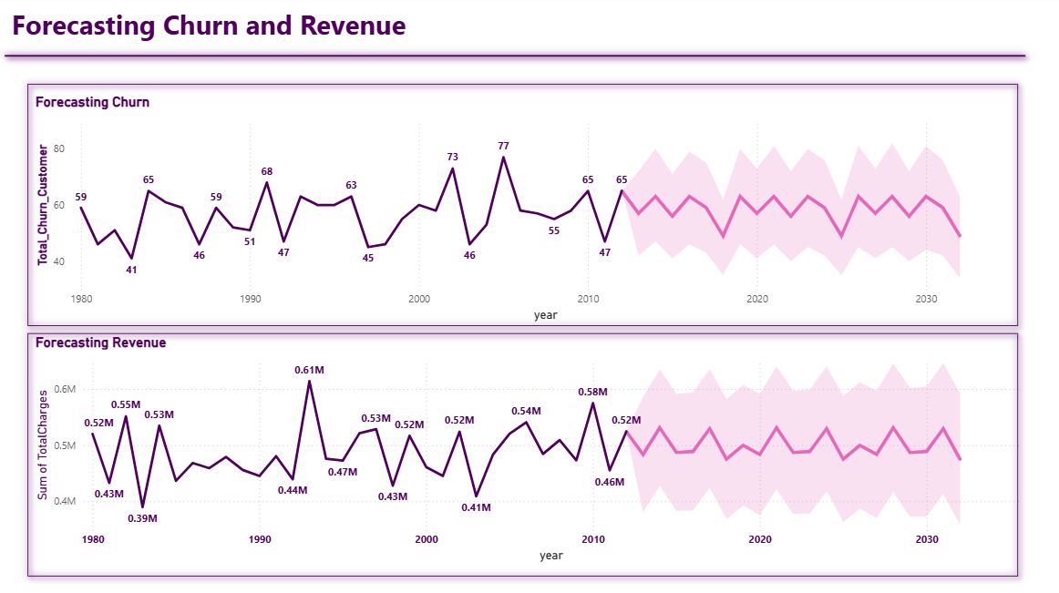

Slide 26
From the overall graph, we can observe that monthly dataset contract-type customers are more likely to be churn. Tenure bin wise, the 0-20 age group customers has more possibility to churn. Gender wise, female customers, who have adopted monthly contracts have more possibility to be as compared to male customers. Those who have not taken any kind of Tech support, that type of customers have more possibility to ne churned. For those who use Fiber optic connections, that type of customer’s churn percentage was high.
SUMMARY

Slide 27
Presented By : Soumyadeep Maity Sayak Manna Rohit Sarkar
THANK YOU

